Slide 1
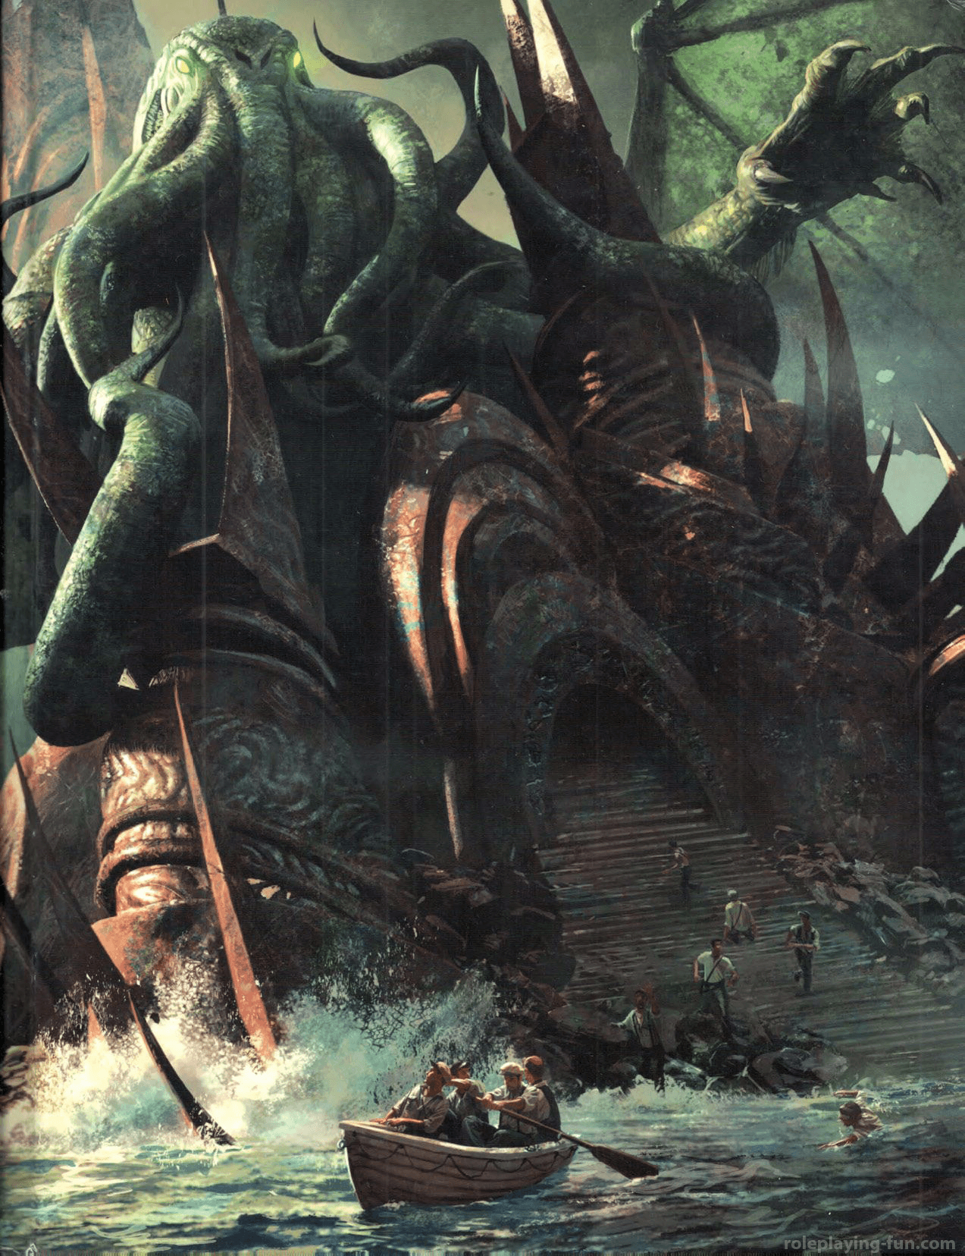
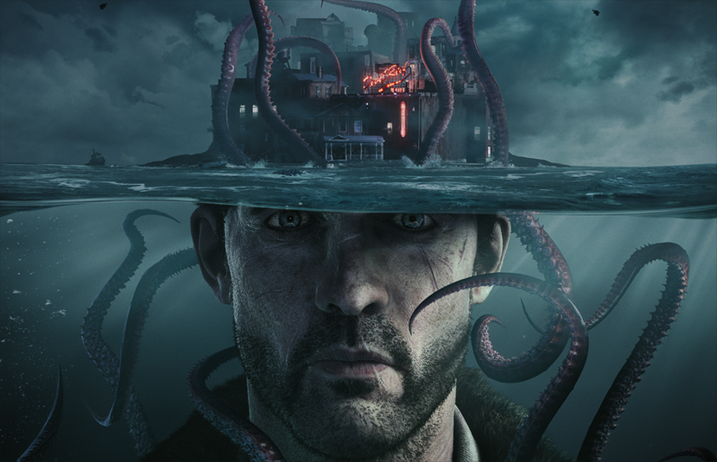
Lovecraftian Horror
-By Akshat Srivastav

Slide 2
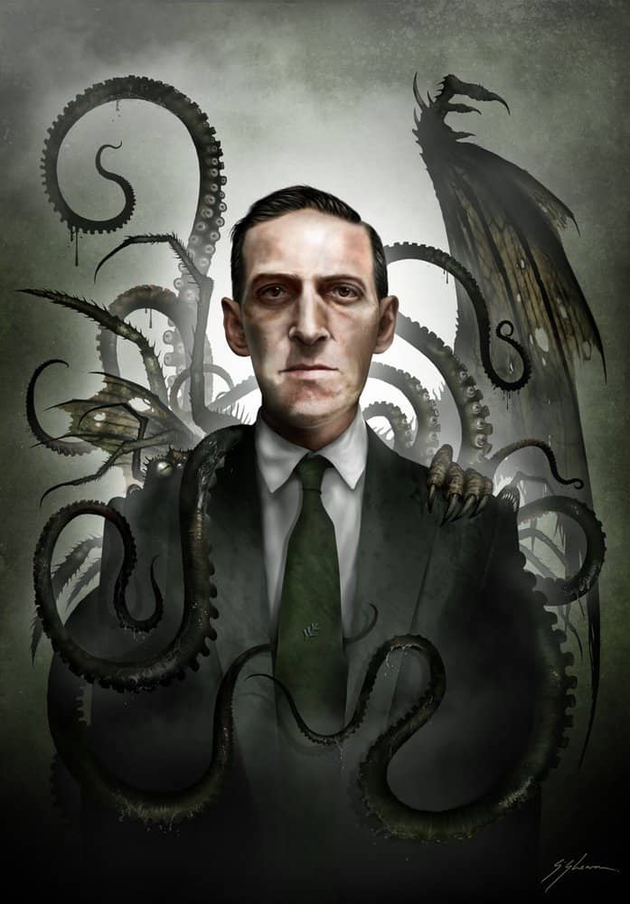
H.P. LOVECRAFT
H.P Lovecraft was a writer of weird and horror fiction around the early 20th century.
Most of his work revolves around the subgenre that is cosmic horror which is a lot of times referred to as Lovecraftian horror.
He has had a huge impact on how we view horror nowadays.

Slide 3
Lovecraftian Horror
What is it?
It’s a type of horror genre that plays on how we as humans feel fear and awe when confronted by a phenomena beyond our comprehension, the sense that ordinary life is a thin shell over a reality that is so alien and abstract in comparison that merely contemplating it would damage the sanity of the ordinary person.
-

Slide 4
How is it unique?
Lovecraft refined cosmic horror and the type of storytelling into his own mythos that involved a set of supernatural, pre-human and extraterrestrial elements
His work tends not to focus on characterization of humans, in line with his view of humanity’s insignificant place in the universe.
He had an antiquarian writing style.
-
Detachment. Lovecraftian heroes tend to be social outcasts usually with an academic or scholarly view on the antagonist, be it a monster, or a situation.

Slide 5
Helplessness and hopelessness. Although Lovecraftian heroes may deal an occasional setback to the antagonist, their victories are almost always temporary and they usually end up paying a price for it and hence the horror that no matter how much we may fight back, the vast uncertainty that is the cosmic presence of the antagonist find a way to fight back and punish us.
Characters in the stories, no matter how well read, don’t understand what’s happening to them and often go fully insane trying to understand it, showing sanity’s fragility and vulnerability.

Slide 6
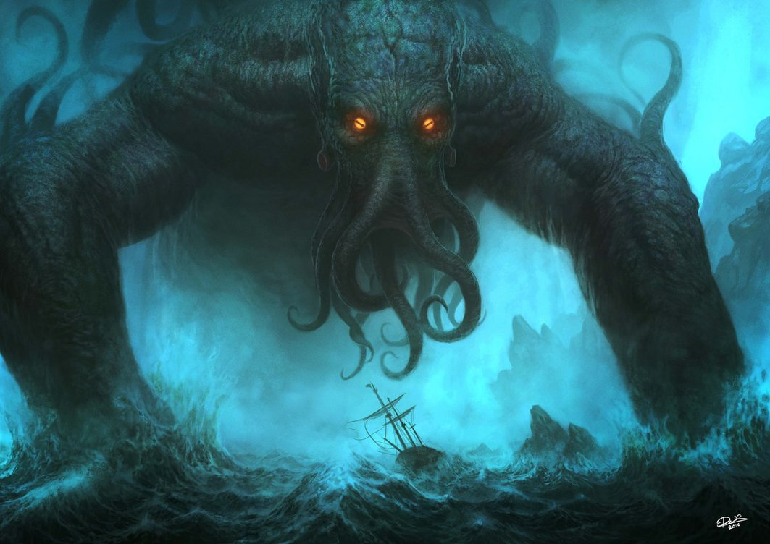
Lovecraftian monsters
-
CTHULHU

Slide 7
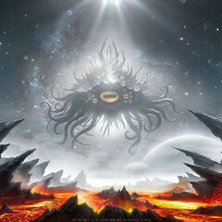
Azathoth (The sleeping fool)

